Slide 1
SLDM -LOAN APPROVAL PREDICTION - GROUP -H
Objective:
To compare the performance of two statistical learning algorithms for loan approval prediction.
Data description:
A synthetic dataset of 20,000 records with 31 features.
Includes financial, demographic, and employment-related features.
Target variable: loan approval status (binary).
Designed to facilitate the development of predictive models for risk assessment

Slide 2
Methodology
1. Data Preprocessing:
Data Reduction: Removed irrelevant columns.
Missing Value Check: No missing values found.
Outlier Detection: No outliers detected.
2. Feature Engineering:
Categorical Encoding: One-hot encoding for categorical variables, label encoding for the target variable.
Numerical Scaling: Standard scaling for continuous features.
3. Exploratory Data Analysis (EDA):
Descriptive Statistics: Calculated summary statistics for continuous variables.
Data Visualizations: Created visualizations for loan approval/denial ratio and loan purpose distribution.
Multicollinearity Check: Used VIF to identify and remove highly correlated variables.
Feature Selection: Removed variables with low correlation to the target variable.
Data Splitting:
Split the dataset into a 60:40 training and testing set ratio.

Slide 3
Statistical models used:
1. Logistic regression:
Model: logistic regression with balanced class weights
Evaluation metrics: accuracy, precision, recall, f1-score, auc-roc
Feature importance: based on coefficient magnitudes
2. Random forest Classifier:
Model: random forest classifier
Evaluation metrics: accuracy, precision, recall, f1-score, auc-roc
Feature importance: based on gini impurity reduction
3. Support vector machine (svm):
Model: linear svm
Evaluation metrics: accuracy, precision, recall, f1-score, auc-roc
Feature importance: based on coefficient magnitudes

Slide 4
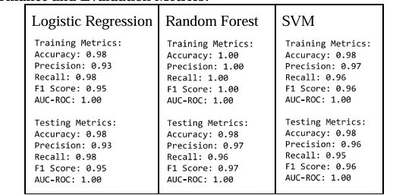
Model Performance and Evaluation Metrics:-
Logistic Regression: Accuracy 98%, Precision 93%, Recall 98%, F1-score 95%, AUC-ROC 1.00, indicating strong performance.
SVM: Accuracy 98%, Precision 97%, Recall 96%, F1-score 96%, AUC-ROC 1.00, confirming excellent classification ability.
Random Forest: Training accuracy 100%, with perfect precision, recall, and F1-scores. Testing accuracy 98%, Precision 97%, AUC-ROC 1.00, showing high class distinction.

Slide 5
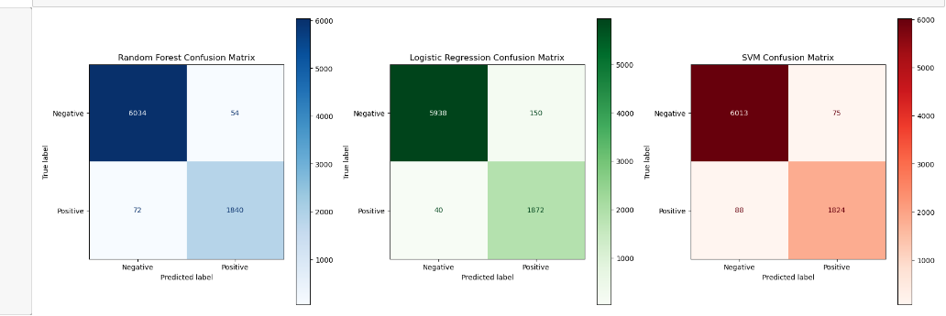
Random Forest:
High accuracy with few false positives and false negatives.
Logistic Regression:
Good accuracy but more prone to false positives.
SVM:
Balanced performance but less accurate in predicting approvals compared to Logistic Regression.

Slide 6
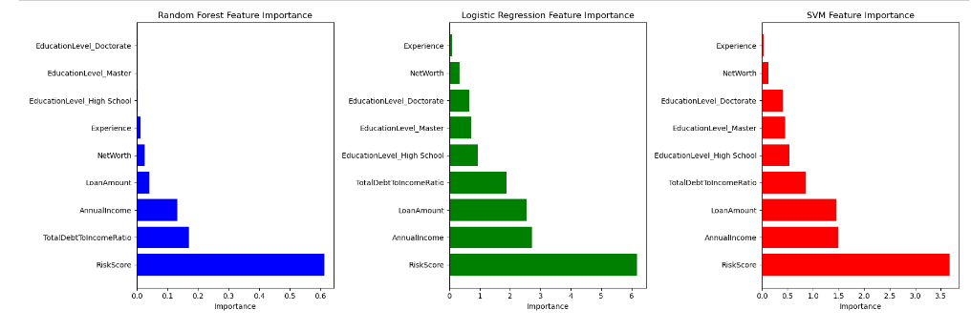
RiskScore is consistently identified as the most critical factor in predicting loan approvals across all models (Random Forest, Logistic Regression, and SVM).
TotalDebtToIncomeRatio, AnnualIncome, and LoanAmount are also significant factors influencing loan approval decisions.
The overall analysis suggests that risk assessment and financial metrics play a crucial role in determining loan approval outcomes.

Slide 7
Conclusion:
Accuracy and Performance:
All models achieve high accuracy (98% on testing).
Random Forest shows perfect training performance, but potential overfitting.
Logistic Regression has high recall, while SVM has higher precision.
Interpretability:
Logistic Regression is the most interpretable.
Random Forest offers some interpretability through feature importance.
SVM is less interpretable.
Best Performing Model:
Random Forest is the top performer due to:
High accuracy and perfect training fit.
Strong feature importance insights, highlighting "RiskScore".
Slightly higher testing precision compared to other models.
Its ensemble nature and focus on key variables contribute to its superior performance.

